Slide 1
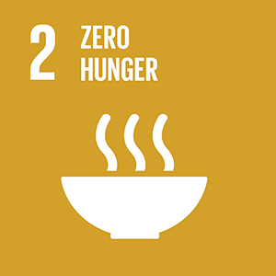
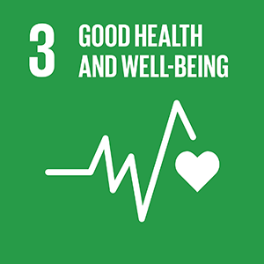
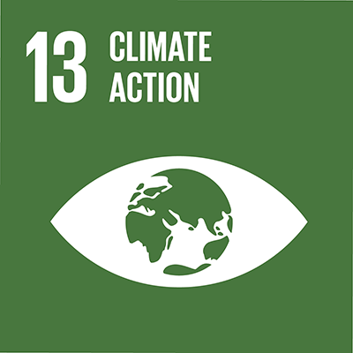
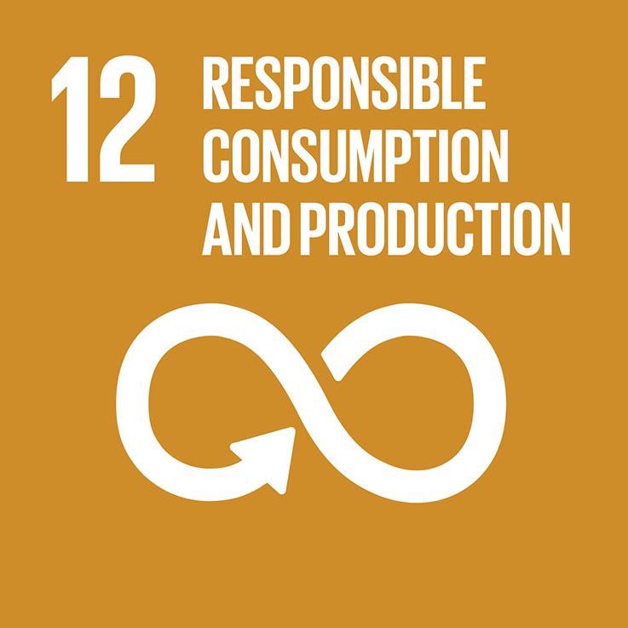
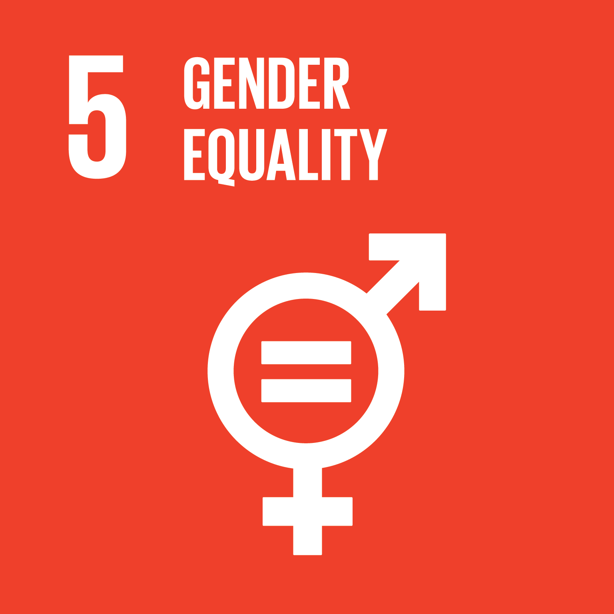
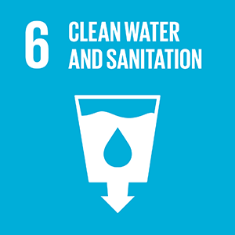
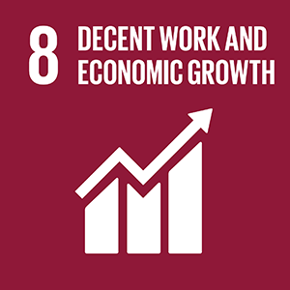
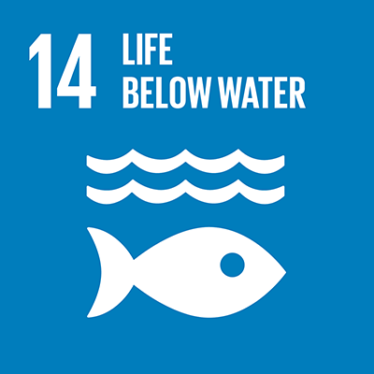
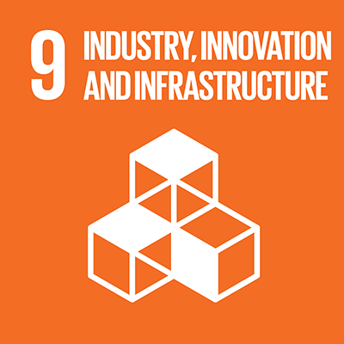
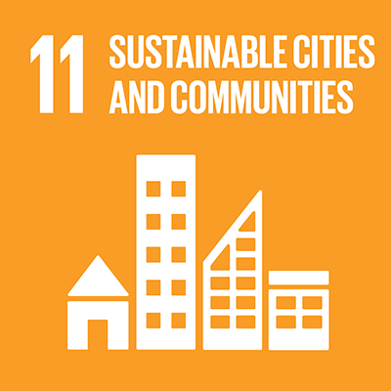
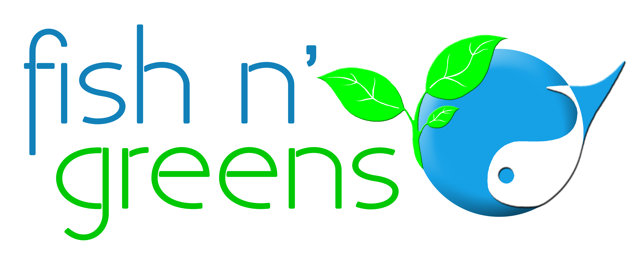
Addressing All These Issues
TIP: Click on each of the SDGs to find out how this project can solve it!
Notes:
Our technology, our food and specifically this project I will detail further on, addresses all these sustainable development goals.

Slide 2
Addressing All These Issues
Due to intensive production of fish and vegetables, allows regions and cities to increase nutritional food self-sufficiency and local availability, including fresh fish protein and vegetables, even in adverse climatic or epidemic conditions.
GO BACK

Slide 3
Addressing All These Issues
Actively developing education, workshops and school guided tours, to teach students about healthy and sustainable food!
Train new professionals and receive internships in partnership with universities.
GO BACK

Slide 4
Addressing All These Issues
Aquaponics is inclusive and promotes gender equality across all of its tasks. It is a form of ergonomic production that does not require significant physical efforts. There are no specifically masculine or specifically feminine tasks!
We care for gender equality in the whole project!
GO BACK

Slide 5
Addressing All These Issues
Growing fresh food in a sustainable way without wasting water, continuously recycling it in a 100% closed loop and without effluents discharge!
With our technology, we have a solid waste management system that generates water savings of over 95% compared to conventional farming!
GO BACK

Slide 6
Addressing All These Issues
The project involves innovative design in integrating new technologies to sustainably generate high quality fish protein and vegetables. These systems can be replicated in different cities and regions, extending the benefits to many communities.
These are innovative aquaculture and hydroponics technologies designed to increase food security and productivity in very limited area, with no environmental impact and using very few resources (less waste, less maintenance, less water and less energy).
GO BACK

Slide 7
Addressing All These Issues
Through innovation in aquaculture and agriculture smart and sustainable technology, we provide fresh food to close population, in densely populated areas, avoiding transportation and making cities greener and more self-sufficient.
Intention to involve local communities (such as schools, in partnership with municipalities or NGOs) through education for healthy eating, food cultivation and environmental sustainability.
The project is scalable to be quickly replicated on the outskirts of other European cities.
GO BACK

Slide 8
Addressing All These Issues
Each new facility has the capacity to produce and deliver pure, fresh, tasty, local and healthy food (110 tons of fish and 400 tons of diversified vegetables), without the use of pesticides, herbicides, synthetic fertilizers or medicines.
In addition, fish protein is of high quality without any contaminants such as heavy metals, microplastics or Bisphenol.
Foods that replicate nature!
GO BACK

Slide 9
Addressing All These Issues
Create and train teams of professionals who will work in an innovative, challenging, ergonomic, collaborative and fairly remunerated environment, rewarding productivity and results.
Create wealth in the region through local production, contributing to reduce food imports and, as such, to a better situation in the country's balance of trade.
GO BACK

Slide 10
Addressing All These Issues
We called our modular aquaponics technology Climate Smart because it not only mitigates climate change but also because it’s climate adaptive, being able to keep producing in catastrophic or adverse climatic conditions.
The production occurs in environmental protected and controlled conditions, not influenced by seasonality, external weather conditions, prolonged drought or extreme water scarcity. In an eventual pandemic situation (e.g. closure of logistical circulation and supplies), the production system manages to continue to maintain production levels.
Compared to conventional farming, this unit saves more than 20 tons of CO₂ emissions per
ton of food produced.
GO BACK

Slide 11
Addressing All These Issues
By not producing carnivorous fish species, fish meal is not necessary, eliminating wild fish catches, that is, reducing the impact on ocean’s fish stocks.
The first unit will be able to generate 110 tons of ASC certified fish per year, which means a potential for reducing wild fish catches in the order of 330 to 450 tons per year.
Unlike other aquaculture production systems, our modular technology does not generate wastewater nor pollutants, which would have a negative impact on natural waterways or the sea.
GO BACK

Slide 12
Addressing All These Issues
The project intervenes in several ways:
Locally grow and deliver sustainable fish and organic vegetables.
A very efficient use of resources (extremely high water savings; rational and optimized use of energy, as well as renewable energy; use of circular economy processes).
Ensuring that no effluent is discharged to the outside of the system.
Ensuring a reduction of about 20 tons of carbon emissions for each ton of food produced (in relation to conventional farming).
Ensuring food safety through new technological techniques and organic production.
Ensuring that fresh, natural and healthy food is made available to local consumers.
For not occupying fertile land (greater availability for biodiversity and native species) and using a small, highly productive footprint close to urban areas.
For education and awareness about environmental sustainability, sustainable food production and healthy food consumption.
GO BACK

